Slide 1

Day3: Build your first AI Model
Youssef A. Khattab
Notes:
Building on yesterday's foundation, today we embark on a deeper exploration of machine learning. We'll delve into supervised and unsupervised learning paradigms, the cornerstones of data-driven prediction and pattern recognition. Prepare to unlock the power of machine learning to make informed decisions based on data!

Slide 2

Welcome back, everyone!
Welcome to the thrilling world of building your very own AI model! In this session, we'll take the first steps on this exciting journey. We'll explore the fundamental concepts behind AI models and guide you through the process of creating your first one.
Notes:
Welcome back, everyone! Today, we embark on a deeper exploration of Machine Learning, a crucial component of AI that empowers machines to learn from data without explicit programming. Through this session, we will gain insights into how ML algorithms are trained and utilized for various purposes. Get ready to unlock the secrets of how machines learn and make predictions!

Slide 3

Your First AI Model: https://shorturl.at/kp145

Slide 4
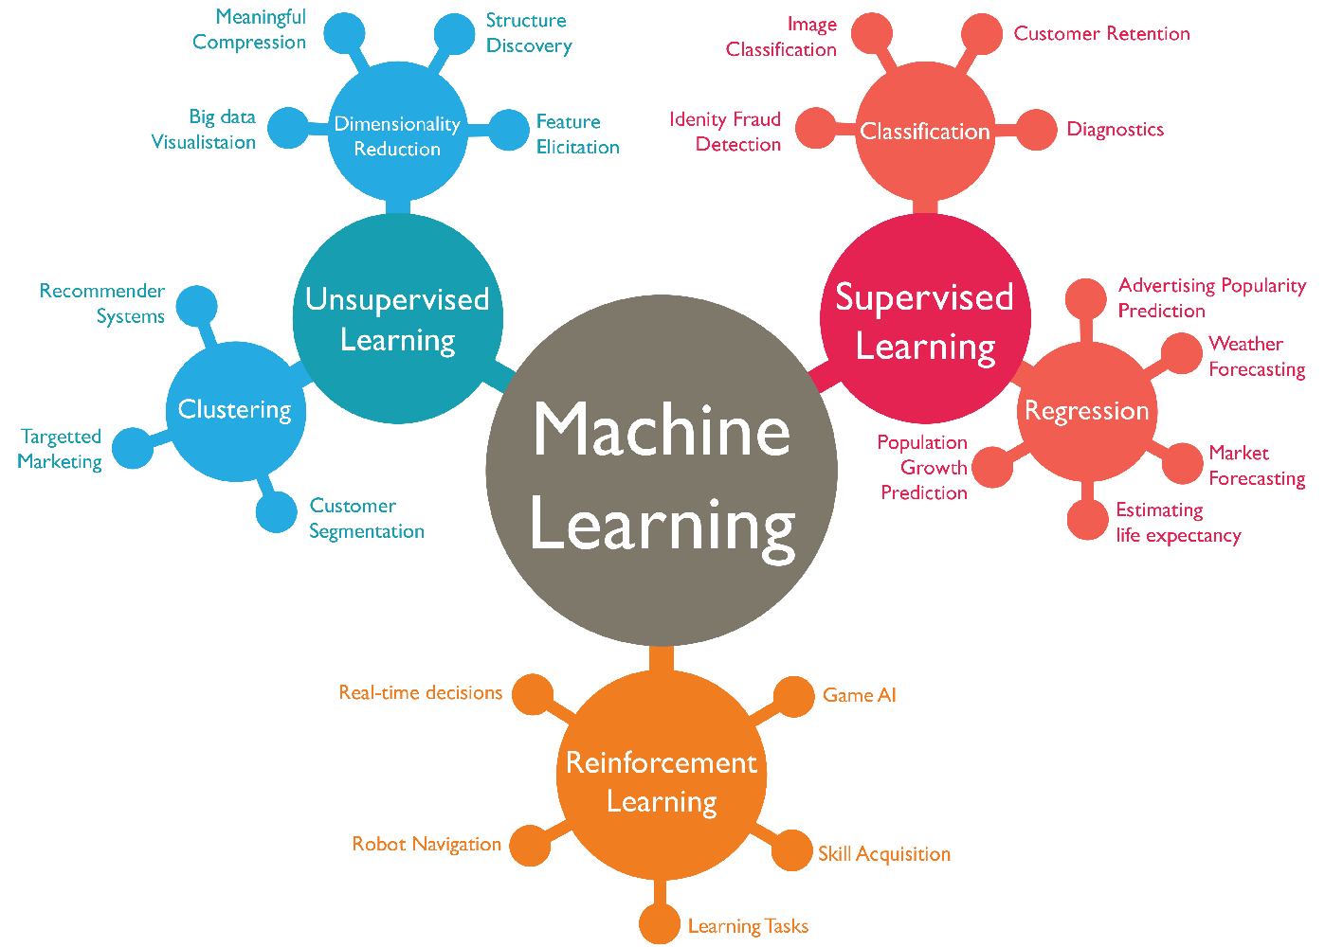
Main types of machine learning algorithms

Slide 5
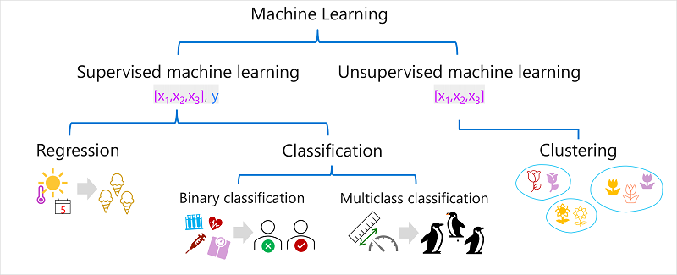

Slide 6
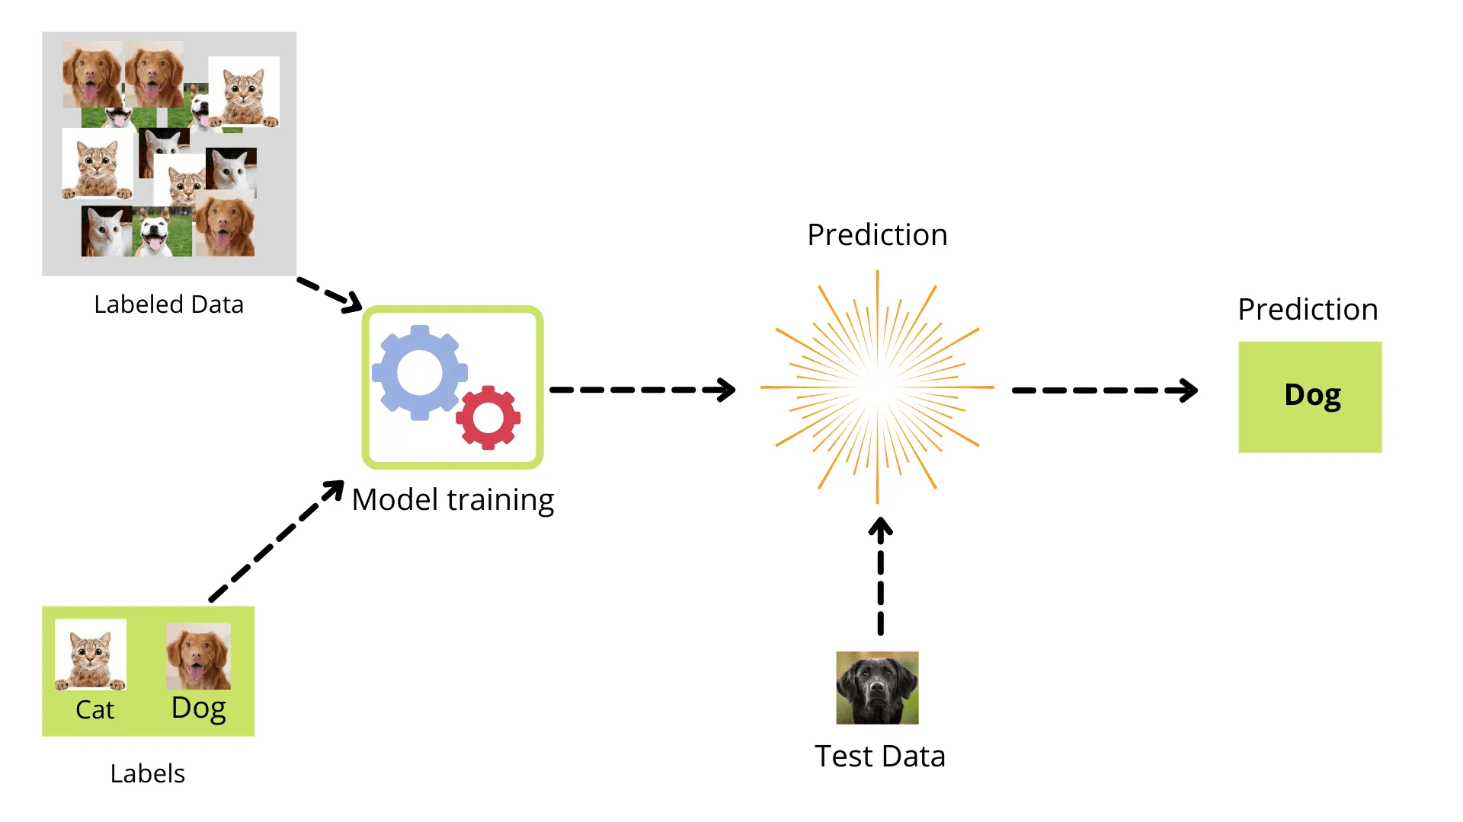
Supervised Learning: Learning from Labeled Examples
Supervised learning trains models using labeled data.
Labeled data consists of input features paired with their corresponding desired outputs (labels).
Analogy: Supervised learning resembles a student acquiring knowledge through a teacher's guidance and feedback.
Notes:
Supervised learning forms a fundamental pillar of machine learning. Imagine a student learning under a teacher's guidance. Similarly, supervised learning algorithms leverage labeled data, where each input has a corresponding label representing the desired output. By analyzing these labeled examples, the model learns to map inputs to outputs, enabling it to make accurate predictions on unseen data.

Slide 7
Common Supervised Learning Algorithms
Supervised learning encompasses a diverse range of algorithms, each tailored to specific tasks.
Here's an overview of some popular examples:
Linear Regression: Models linear relationships between features and a continuous target variable. (e.g., Predicting housing prices based on size and location)
Decision Tree: Classifies data by constructing a tree-like structure of questions and decisions. (e.g., Spam email detection)
Notes:
The landscape of supervised learning algorithms is rich and varied. We'll focus on two prominent examples: Linear Regression excels at continuous prediction tasks, like forecasting sales or estimating stock prices. Decision Trees, on the other hand, are powerful for classification problems, such as spam detection or customer churn prediction.

Slide 8

Interactive Activity: Supervised Learning in Action: Predicting Housing Prices
Let's apply supervised learning in a practical scenario!
We'll build a model to predict housing prices based on features like size, location, and amenities.
Through this hands-on experience, you'll gain valuable insights into the workings of supervised learning.
Notes:
Get ready for an engaging activity! We'll leverage a real-world dataset to construct a supervised learning model for predicting housing prices. We'll explore different algorithms and witness the power of data-driven prediction firsthand. This interactive session will solidify your understanding of supervised learning and its real-world applications.

Slide 9
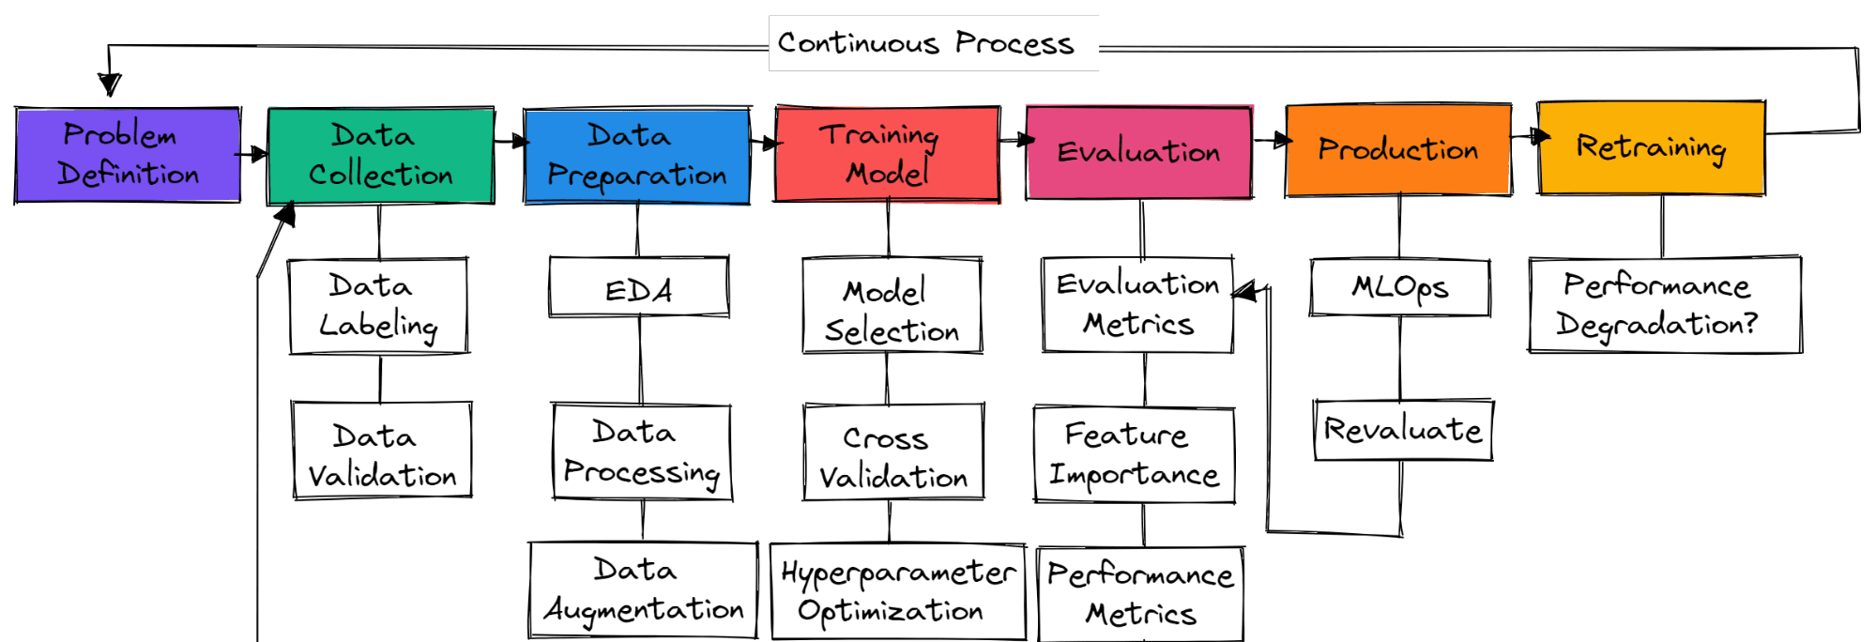
How to Start a Machine Learning Project?

Slide 10
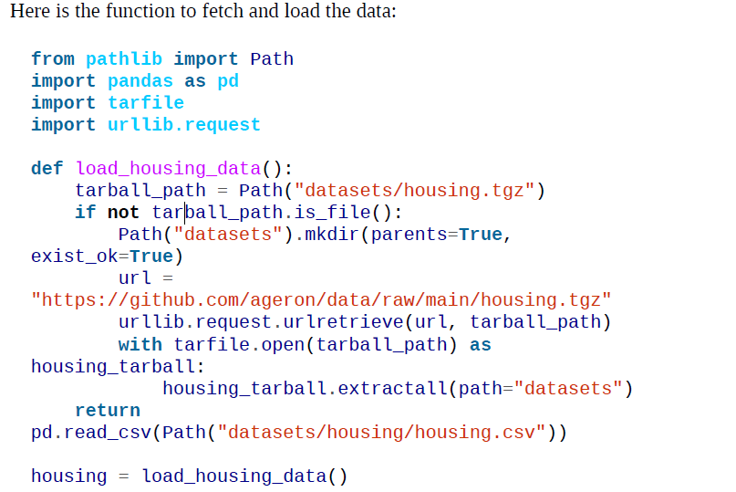
Download the Data

Slide 11
A Quick Look at the Data Structure

Slide 12
Summary of the numerical attributes

Slide 13
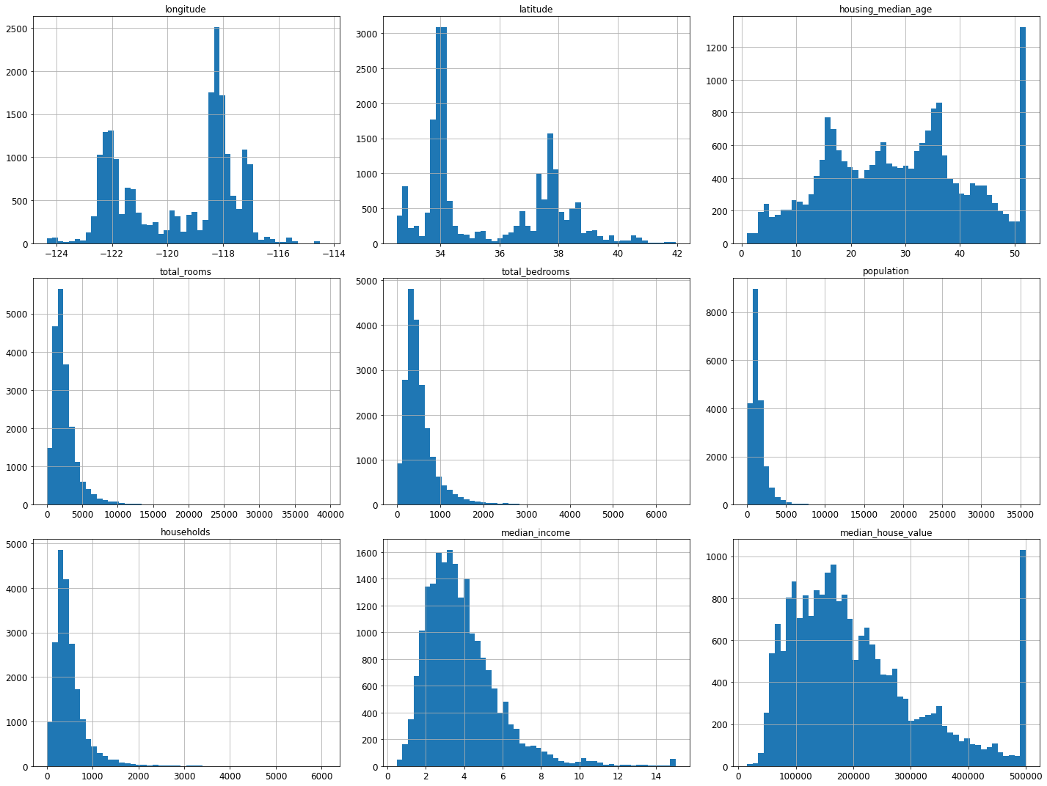
Visualize histogram for each numerical attribute

Slide 14
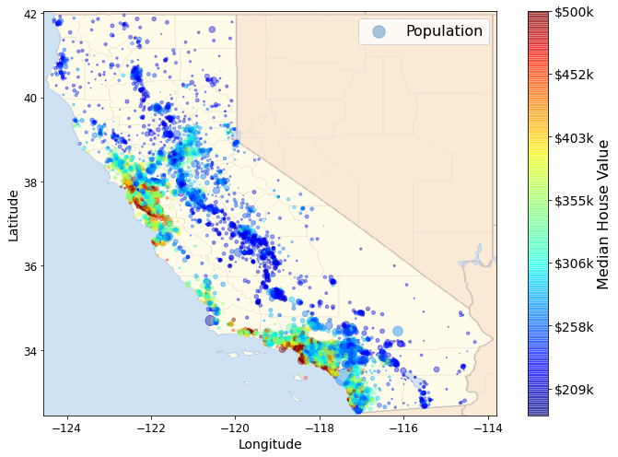
Visualizing Geographical Data

Slide 15
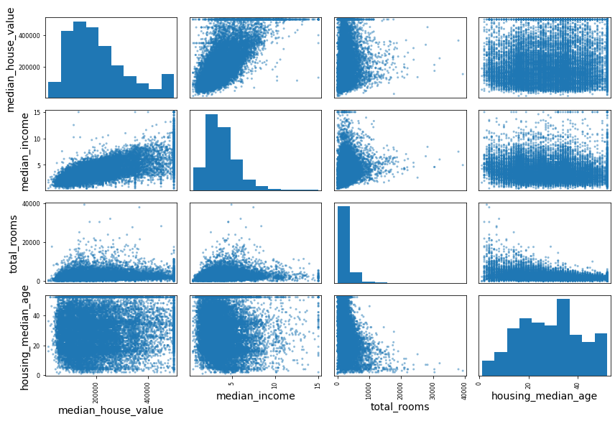
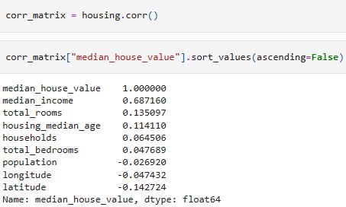
Looking for Correlations

Slide 16
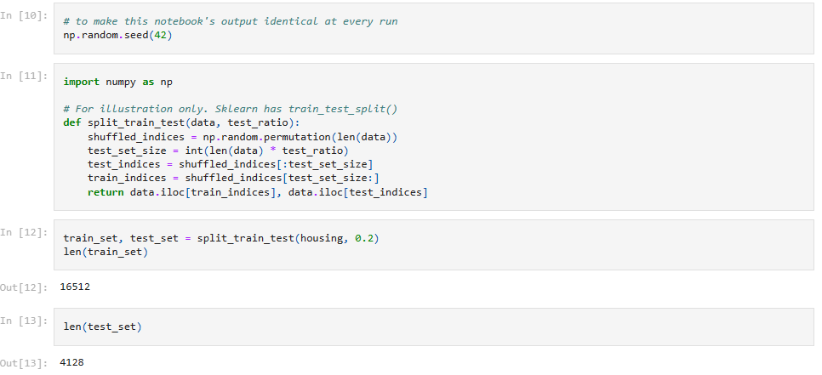
Create a Test Set (Evaluation)

Slide 17
Prepare the Data
Data Cleaning
Examples:
housing.dropna(subset=["total_bedrooms"]) # option 1
housing.drop("total_bedrooms", axis=1) # option 2
median = housing["total_bedrooms"].median() # option 3
housing["total_bedrooms"].fillna(median, inplace=True)

Slide 18
Prepare the Data
Handling Text and Categorical Attributes
housing_cat_encoded=ordinal_encoder.fit_transform(housing_cat)# option 1
housing_cat_1hot = cat_encoder.fit_transform(housing_cat)
# option 2
cat_encoder = OneHotEncoder(sparse=False)
housing_cat_1hot = cat_encoder.fit_transform(housing_cat) # option 3

Slide 19
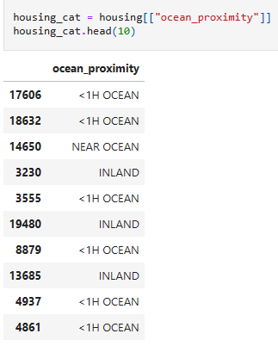
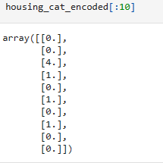
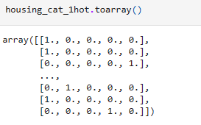
Handling Categorical Attributes Results

Slide 20
Feature Scaling and Transformation
One of the most important transformations you need to apply to your data is feature scaling. With few exceptions, machine learning algorithms don’t perform well when the input numerical attributes have very different scales.
Min-max scaling (ranging from 0 to 1)
from sklearn.preprocessing import MinMaxScaler
min_max_scaler = MinMaxScaler(feature_range=(-1, 1))
housing_num_min_max_scaled = min_max_scaler.fit_transform(housing_num)
Standardization: first subtracts the mean value (so standardized values have a zero mean), then it divides the result by the standard deviation (so standardized values have a standard deviation equal to 1).
from sklearn.preprocessing import StandardScaler
std_scaler = StandardScaler()
housing_num_std_scaled = std_scaler.fit_transform(housing_num)

Slide 21
Feature Scaling Result

Slide 22
Select and Train a Model
At last! You framed the problem, you got the data and explored it, you sampled a training set and a test set, and you wrote a preprocessing pipeline to automatically clean up and prepare your data for machine learning algorithms. You are now ready to select and train a machine learning model. The good news is that thanks to all these previous steps, things are now going to be easy! You decide to train a very basic linear regression model to get started:
> from sklearn.linear_model import LinearRegression
> lin_reg = LinearRegression()
> lin_reg.fit(housing_prepared, housing_labels)

Slide 23
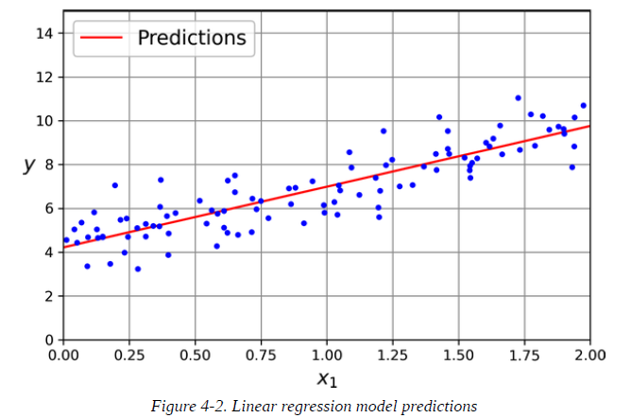
Model Predictions

Slide 24
Conclusion
Today's journey has equipped you with a deeper understanding of machine learning.
We explored supervised and unsupervised learning paradigms, empowering you to harness the power of data for prediction and pattern recognition.
Remember, machine learning is an ever-evolving field with boundless potential. Keep exploring and learning!
Notes:
Congratulations! Today's session has unveiled the captivating world of supervised and unsupervised learning. We've delved into the core concepts, explored popular algorithms, and even participated in a hands-on activity. This foundation empowers you to leverage machine learning for various tasks, from forecasting trends to uncovering hidden patterns in data. As you embark on your machine learning journey, remember that this field is constantly pushing boundaries. Stay curious, keep exploring, and embrace the power of data to unlock new possibilities!

Slide 25
Additional part: ML Journey

Slide 26
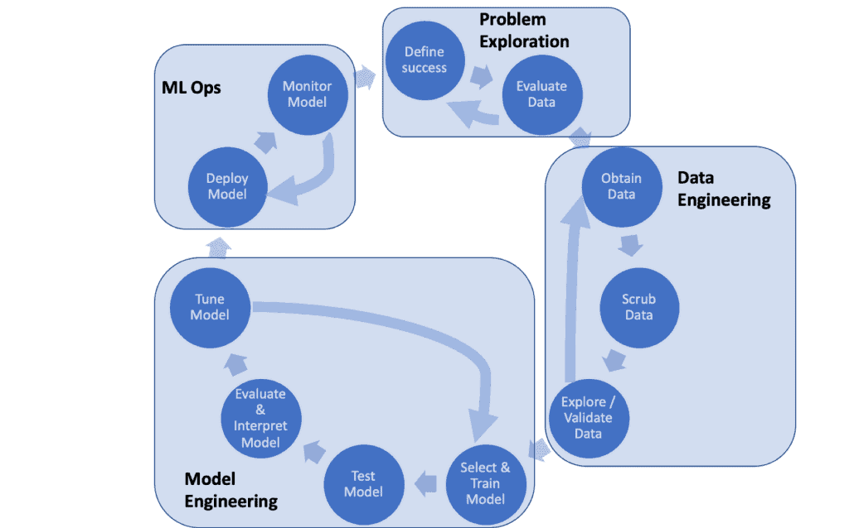
Machine Learning Process

Slide 27

Problem Exploration
First focus on how the model will be used.
In the process, assess the desired model accuracy and explore other details, such as if false positives are worse than false negatives. This phase also includes understanding what data might be available.
Define Success: Define the problem to be solved. For example, what should be predicted. This helps define what data will be needed. Also, make sure it’s clear how success will be measured.
Evaluate Data: Determine what are the relevant data sources. In other words, evaluate what data the team will need, how that data is collected, and where the data is stored.

Slide 28

Data Engineering
Design and build data pipelines. These pipelines get, clean and transform data into a format that is more easily used to build a predictive model. Note that this data might be coming from multiple data sources, so merging the data is also a key aspect of data engineering. This is often where the most time is spent in an ML project.
Obtain Data: Assembling the data. This includes connecting to remove data stored and databases, which might be in different formats. For example, some data might be in CSV format, and other data could be available in JSON via web services.
Scrub Data: The process of re-formatting particular attributes and correcting errors in data, such as missing values imputation. Datasets are often missing values, or they may contain values of the wrong type or range. Cleaning can include removing duplicates, correcting errors, dealing with missing values, normalization, and handling data type conversions.
Explore / Validate Data: Get a basic understanding of the data. This exploratory analysis includes data profiling to obtain information about the content and structure of the data. The goal is to both understand the data attributes as well as the quality of the data.

Slide 29
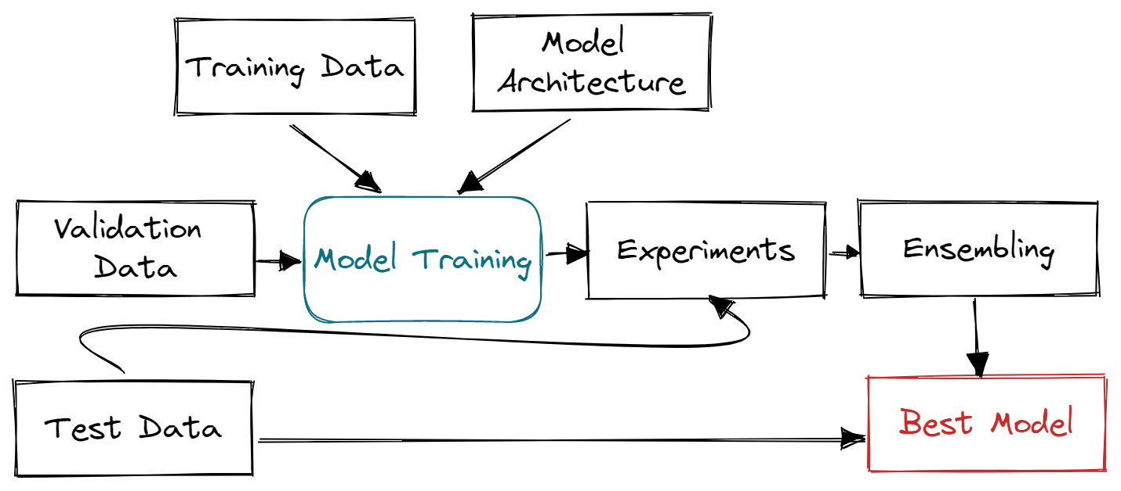
Model Engineering
This is the phase that most people associate with building a machine learning model. During this phase, data is used to train and evaluate the model. This is often an iterative task, where the different models are tried, and the model is tuned.
Select & Train Model: Identify suitable models and train them using training data to achieve the desired prediction accuracy.
Test Model: Assess model performance on unseen data (testing data) to ensure generalizability and robustness.
Evaluate & Interpret Model: Objectively measure model performance, considering metrics like accuracy and precision, and understand its strengths and weaknesses.
Tune Model: Adjust model parameters to improve performance and address specific requirements, ensuring optimal model performance.

Slide 30
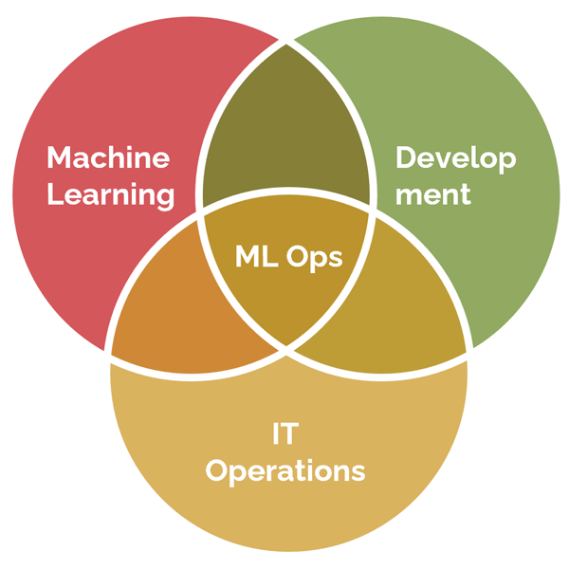
ML Ops
Broadly defined, machine learning operations (ML Ops) spans a wide set of practices, systems, and responsibilities that data scientists, data engineers, cloud engineers, IT operations, and business stakeholders use to deploy, scale, and maintain machine learning solutions.
Deploy Model: Package and put the model to use (i.e., into production). While this varies from one group to another, the team needs to understand the expected model performance, how the model will be monitored, and in general, key performance indicators (KPIs) of the model.
Monitor Model: Maintain the model in production. This includes monitoring the KPIs and proactively working to ensure stable and robust predictions.

Slide 31
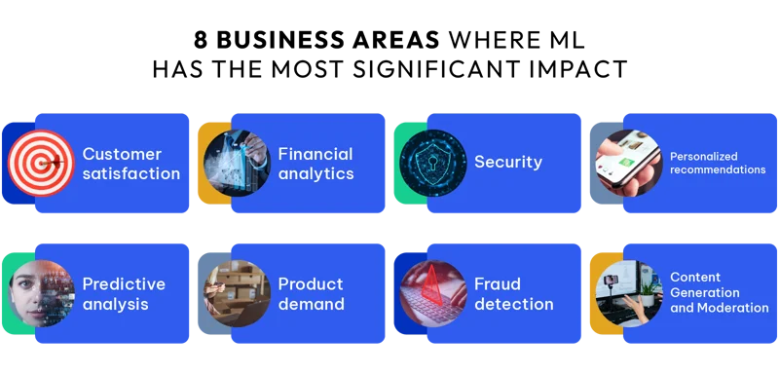

Slide 32

ML Use-cases & Applications

Slide 33
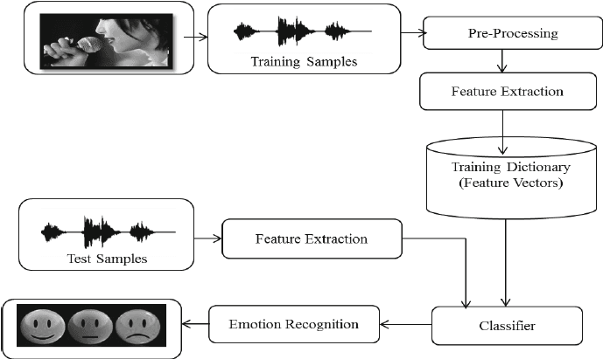
Speech Emotion Recognition with librosa
In the Speech Emotion Recognition with Librosa project, you will process sound files using Librosa, sound file, and sklearn for the MLPClassifier to recognize emotion from sound files.
You will load and process sound files, perform feature extraction, and train the Multi-Layer Perceptron classifier model. The project will teach you the basics of audio processing so that you can advance into training a deep learning model to achieve better accuracy.

Slide 34
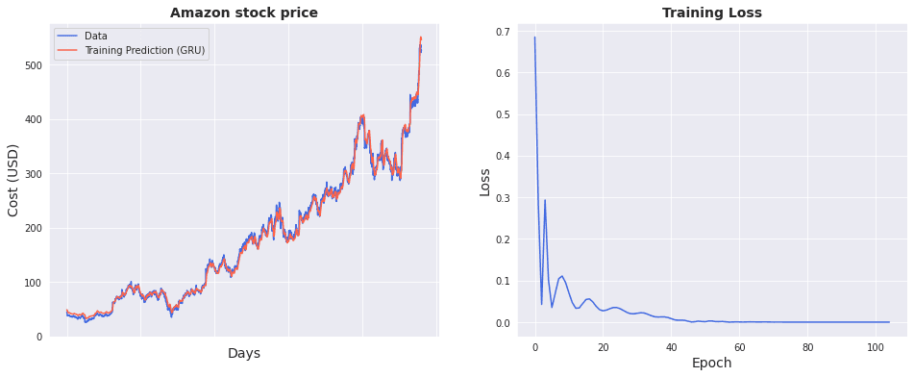
Stock Market Analysis And Forecasting
In the Stock Market Analysis And Forecasting project, you will use GRUs (Gated Recurrent Unit) to build deep learning forecasting models for predicting stock prices of Amazon, IBM, and Microsoft.
In the first part, you will dive deep into times series analytics to learn about trends and seasonality of stock price, and then you will use this information to process your data and build a GRU model using PyTorch. For guidance, you can check out the code source on GitHub.

Slide 35
Reinforcement Learning for Connect X
The Connect X is a getting started simulation competition by Kaggle. Build an RL (Reinforcement Learning) agent to compete against other Kaggle competition participants.
You will first learn how the game works and create a dummy functional agent for a baseline. After that, you will start experimenting with various RL algorithms and model architectures. You can try building a model on Deep Q-learning or Proximal Policy Optimization algorithm.

Slide 36
What are the roles and positions in the field?
Data Scientist: Analyzes complex data to derive insights and build predictive models.
Machine Learning Engineer: Develops ML algorithms and deploys them into production systems.
AI Research Scientist: Conducts research to advance the field of AI and develop innovative algorithms.
Data Engineer: Designs and builds data pipelines to support ML and AI applications.
AI Product Manager: Oversees the development and implementation of AI-powered products and services.

Slide 37
What to Study?
Technical Expertise: Statistics, calculus, linear algebra, programming (Python, R), machine learning frameworks (TensorFlow, PyTorch).
Soft Skills: Communication, problem-solving, critical thinking, collaboration, ethical considerations.
Industry Knowledge: Gain specialization in your chosen domain (e.g., healthcare, finance, security) for deeper impact.

Slide 38

Future of a Career in ML
Growing Demand: With increasing adoption of AI and ML across industries, demand for skilled professionals continues to rise.
Diverse Opportunities: ML careers span various sectors, including healthcare, finance, retail, and entertainment, offering diverse and rewarding career paths.
Continuous Innovation: As the field evolves, ML professionals have opportunities to work on cutting-edge research and develop groundbreaking solutions to complex problems.
Lifelong Learning: ML is a dynamic field that requires continuous learning and adaptation to stay updated with the latest techniques, technologies, and trends.
Impactful Contributions: ML professionals have the opportunity to make a meaningful impact on society by leveraging AI to address global challenges and improve people's lives.

Slide 39

Q&A

